Slide 1


OBJECT ORIENTED PROGRAMMING THROUGH JAVA

Slide 2

L3-JAVA BUZZWORDS

Slide 3


Slide 4
FEATURES OF JAVA OR JAVA BUZZ WORDS
Simple
Object-Oriented
Portable
Platform independent
Secured
Robust
Architecture neutral
Interpreted
High Performance
Multithreaded
Distributed
Dynamic

Slide 5
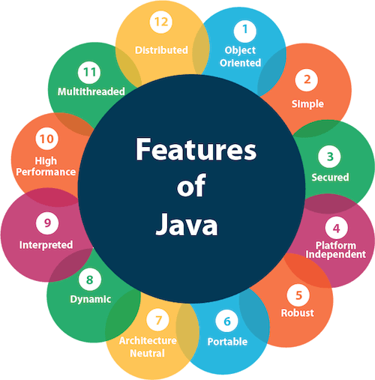

Slide 6
1.Simple
Java is very easy to learn, and its syntax is simple, clean and easy to understand. According to Sun Microsystem, Java language is a simple programming language because:Java syntax is based on C++ (so easier for programmers to learn it after C++).
Java has removed many complicated and rarely-used features, for example, explicit pointers, operator overloading, etc.
2. Object-oriented
Java is an object-oriented programming language. Everything in Java is an object. Object-oriented means we organize our software as a combination of different types of objects that incorporate both data and behaviour.
Object-oriented programming (OOPs) is a methodology that simplifies software development and maintenance by providing some rules.

Slide 7

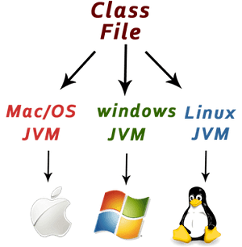
3.Platform Independent
Java is platform independent because it is different from other languages like C, C++, etc. which are compiled into platform specific machines while Java is a write once, run anywhere language.
A platform is the hardware or software environment in which a program runs.
4.Secured
Java is best known for its security. With Java, we can develop virus-free systems.
Java is secured because:
No explicit pointer
Java Programs run inside a virtual machine sandbox

Slide 8
5.Portable
Java programs can be easily moved from one computer system to another, anywhere and anytime. This is the reason why Java has become a popular language for programming on Internet.
6.Architecture Neutral:-
Java is architecture neutral because there are no implementation dependent features, for example, the size of primitive types is fixed.
In C programming, int data type occupies 2 bytes of memory for 32-bit architecture and 4 bytes of memory for 64-bit architecture.
However, it occupies 4 bytes of memory for both 32 and 64-bit architectures in Java.

Slide 9
7.Robust:-
The English mining of Robust is strong. Java is robust because:
It uses strong memory management.
There is a lack of pointers that avoids security problems.
Java provides automatic garbage collection which runs on the Java Virtual Machine to get rid of objects which are not being used by a Java application anymore.
There are exception handling and the type checking mechanism in Java. All these points make Java robust.
8.Dynamic:
Java is a dynamic language. It supports the dynamic loading of classes. It means classes are loaded on demand. It also supports functions from its native languages, i.e., C and C++.
Java supports dynamic compilation and automatic memory management (garbage collection).

Slide 10
9.Interpreted-
JAVA is both compiled and interpreted language.
10.Multithreaded:-
A thread is like a separate program, executing concurrently. We can write Java programs that deal with many tasks at once by defining multiple threads. The main advantage of multi-threading is that it doesn't occupy memory for each thread. It shares a common memory area. Threads are important for multi-media, Web applications, etc.
11.Distributed:-
Java is distributed because it facilitates users to create distributed applications in Java. RMI and EJB are used for creating distributed applications. This feature of Java makes us able to access files by calling the methods from any machine on the internet.
12.High-performance:-
Java is faster than other traditional interpreted programming languages because Java bytecode is "close" to native code.

Slide 11
Next….
JVM ARCHITECTURE
Notes:
In Slide Show mode, click the arrow to enter the PowerPoint Getting Started Center.

Slide 12



